Slide 1
BILATERAL BLUR – WEEK 5
Date: 17/07/2024
Name: Duong Van Giang

Slide 2
1. Completed Topic
Date | Topics | Related topic
06/10/2024 – 06/14/2024 06/17/2024 – 06/19/2024 | Erosion, Dilation, Opening, Closing, Back-Hat, White-Hat, HitOrMiss | Morphological Processing
06/20/2024 - 06/21/2024 06/24/2024 – 06/28/2024 | Box Filter, Gaussian Blur, Median filter | Smoothing
 | Histogram Equalization | Histogram Enhancement
07/01/2024 – 07/01/2024 07/15/2024-now | Bilateral Filter

Slide 3

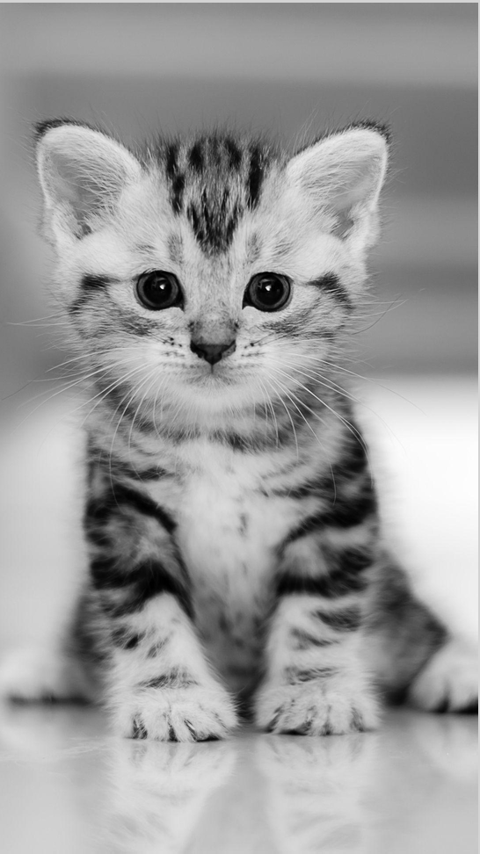
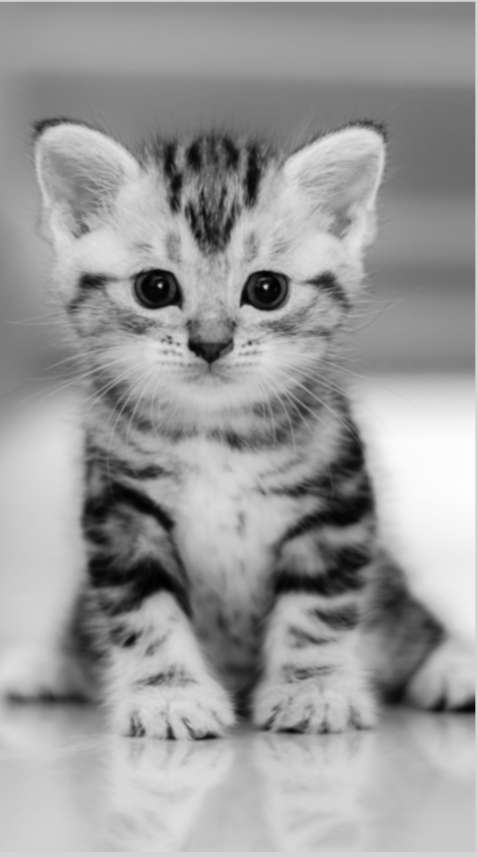
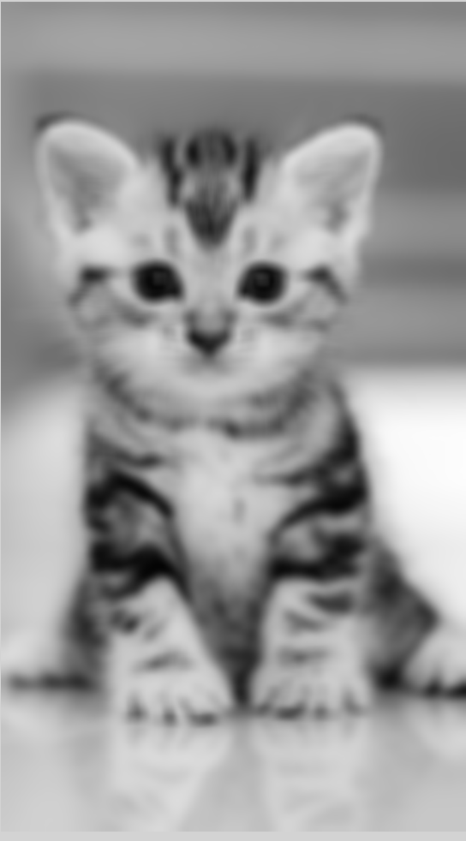
Gaussian Blur and it’s kernel
Gaussian Blur:
Gaussian Blur distributed weight of neighbor pixel base on gaussian distribution. It makes the process of adjust the weight of neighbor pixel only rely on adjust the sigma variable. So it’s easy for human to adjust it’s manually.
Gaussian Blur (kernel 31 x 31, sigma: 2.0)
Gaussian Blur (kernel 31 x 31, sigma: 31.0)
Origin image

Slide 4
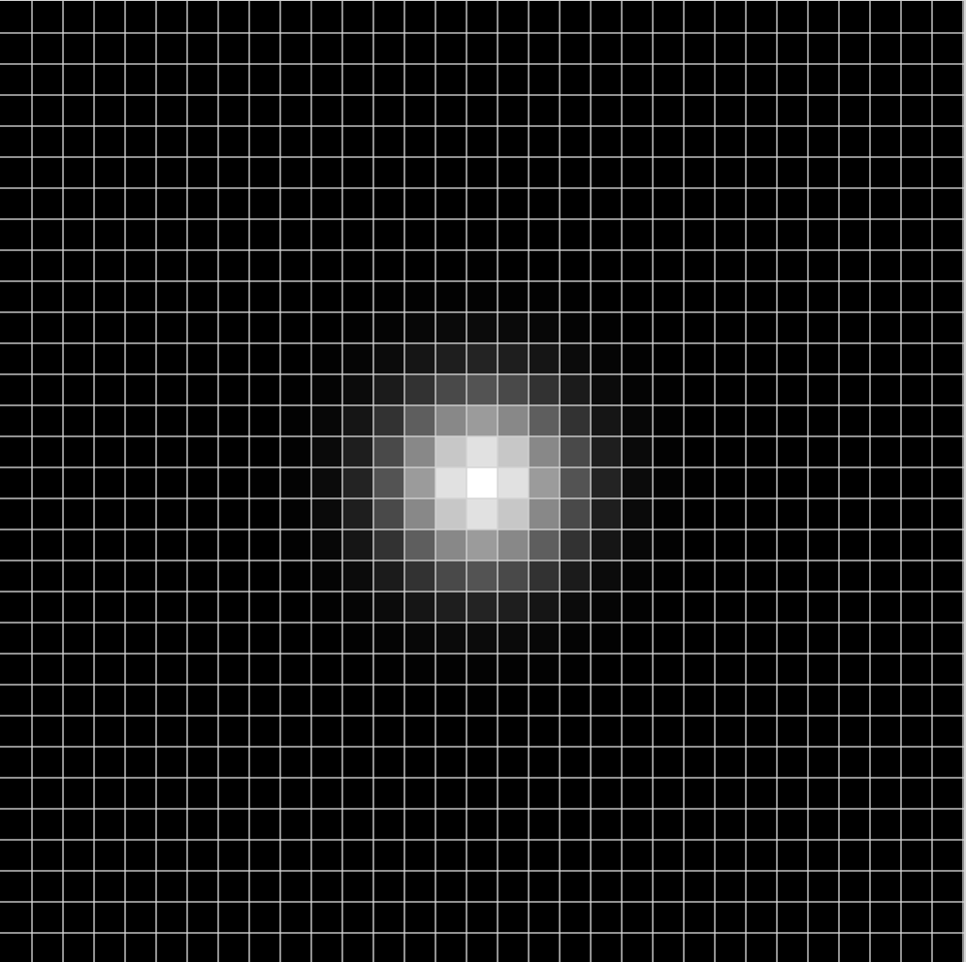

Gaussian
Gaussian Blur (kernel 31 x 31, sigma: 2.0)
The more light the more weight
Origin image
Gaussian Blur (kernel 31 x 31, sigma: 15.0)
If we keep increase the sigma, the kernel will be box filter kernel(average kernel)
0
1

Slide 5
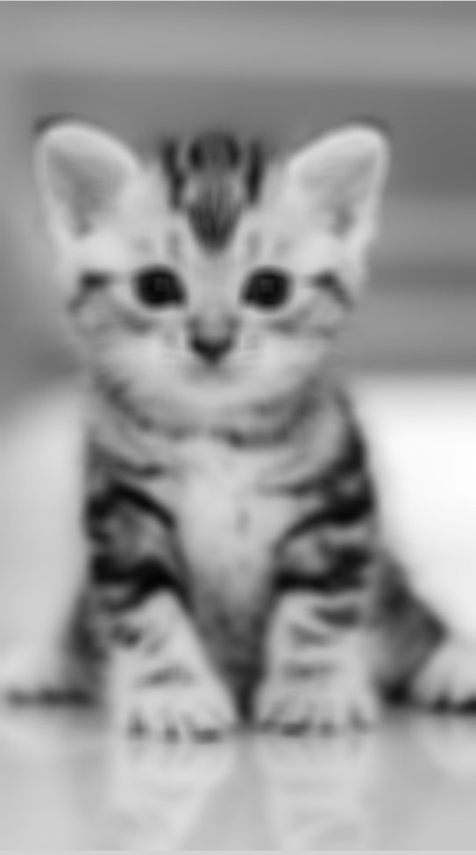
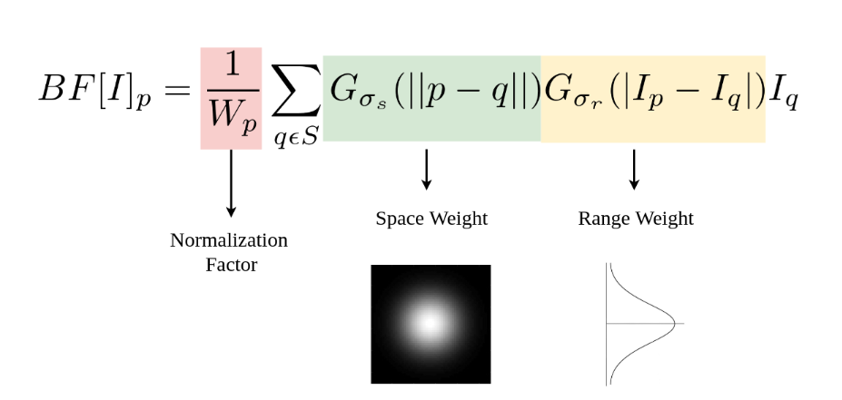
Bilateral Filter
The higher the sigma the more blurry the image have. As the consequence of blurring, the edge of image are getting blur. Blurring edge never a good thing for processing segmentation.
Gaussian
origin
Sigma = 15
Sigma = 75
Bilateral filter keeps the smooth as Gaussian and Box filter. But by combination with the variation of intensity, Bilateral filter keeps the edge too

Slide 6
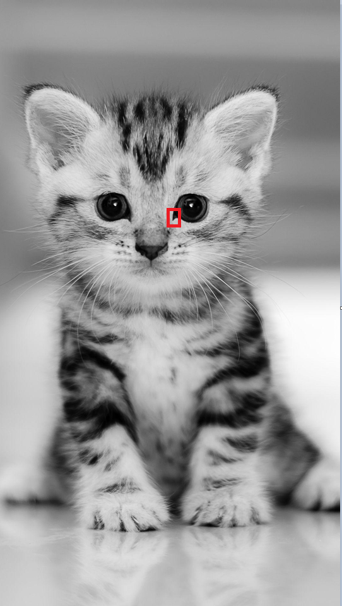
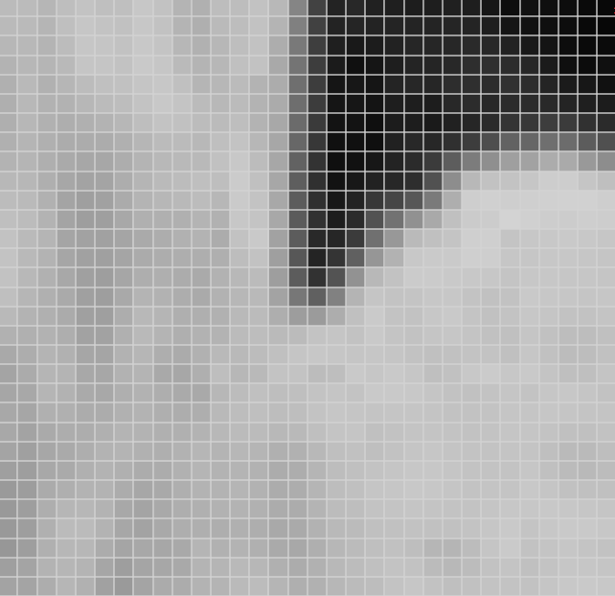
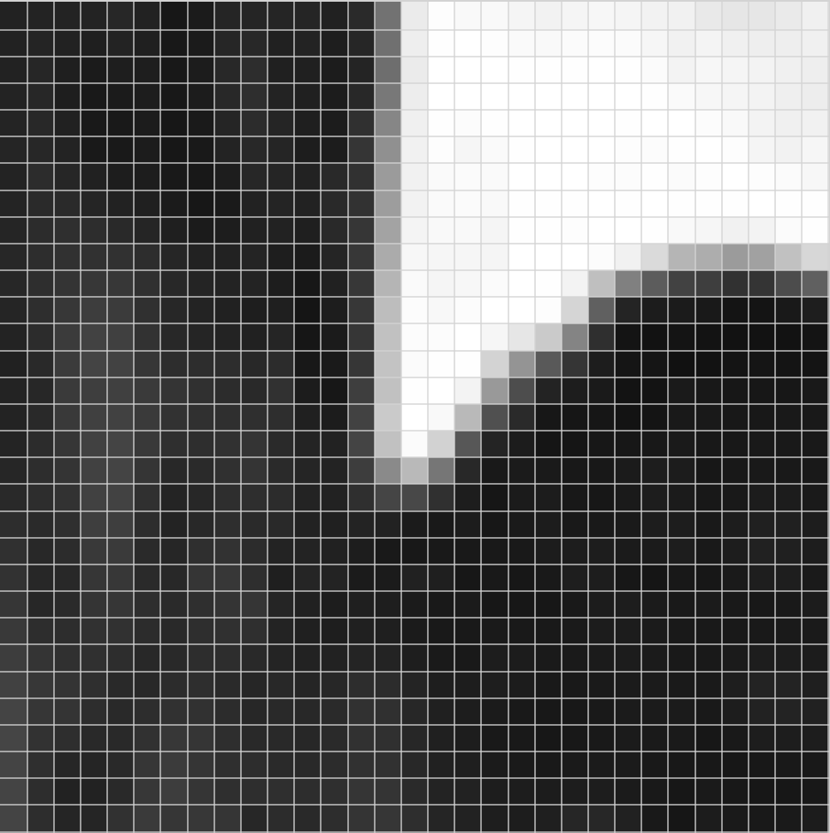
Bilateral Filter – Edge regions
Let study the red part in the right eye of the cat. This is the edge area which was separated eye and fur of the cat.
Space kernel 31x31, sigmas = 15
Studying pixel
Intensity kernel 31x31, Sigmai = 75
0
1

Slide 7
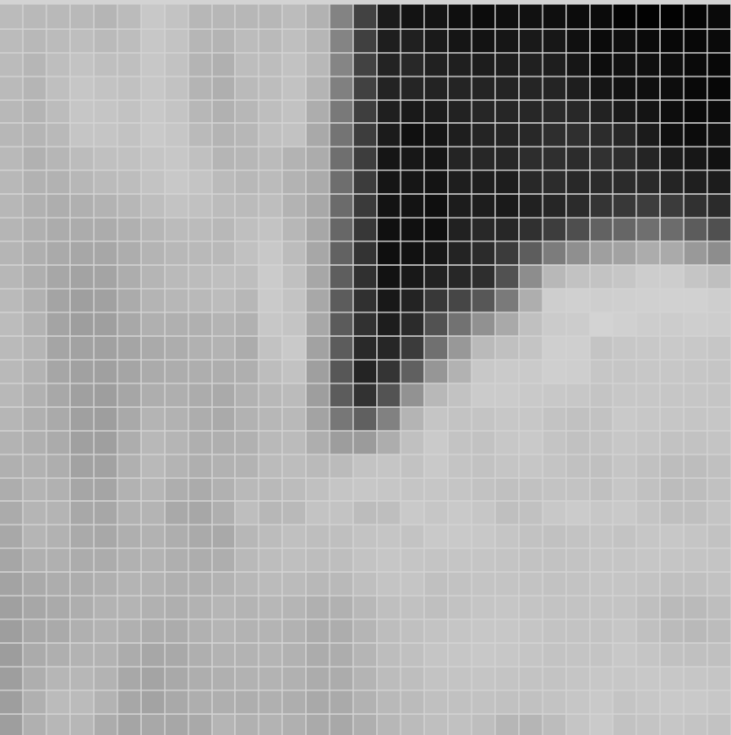
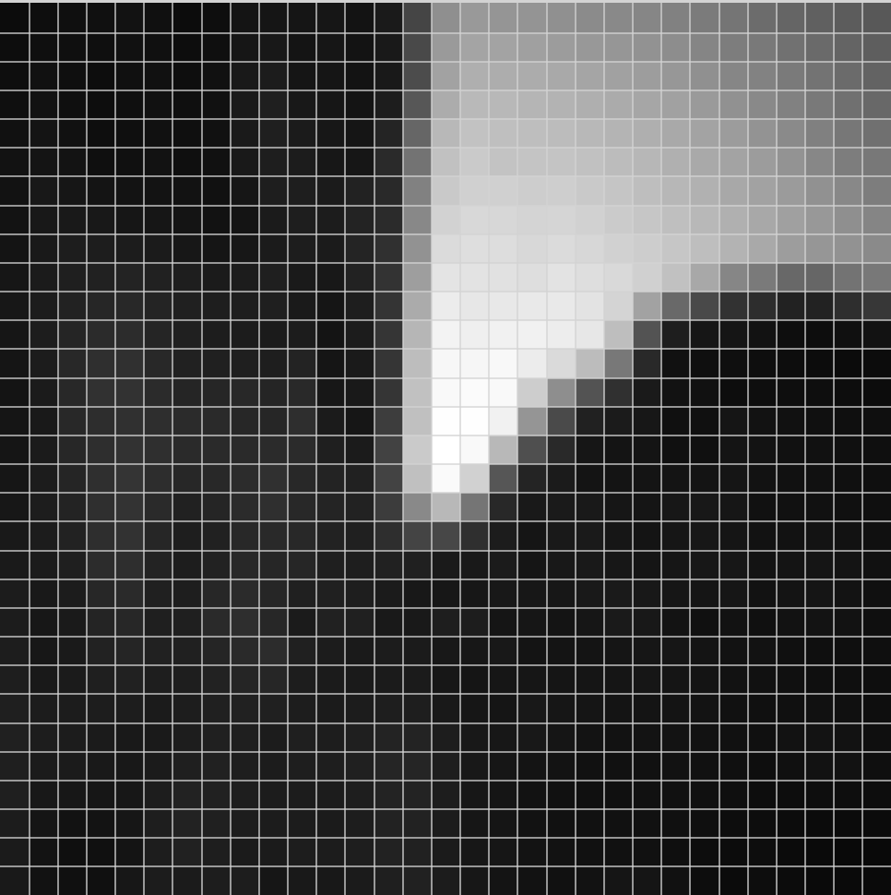
Bilateral Filter – Edge regions
Space kernel 31x31, sigmas = 15
Studying pixel
multiply
Intensity kernel 31x31, Sigmai = 75
0
1

Slide 8
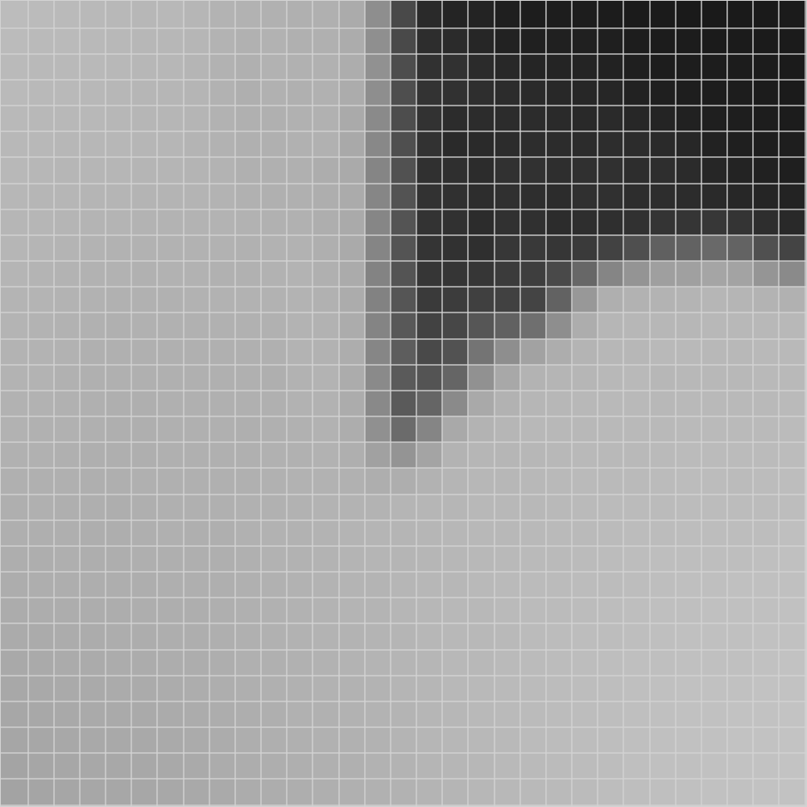

Bilateral Filter – Edge regions
origin
Bilateral:
kernel 31x31,
sigmas = 15,
Sigmai = 75
Gaussian
Kernel 31x31, sigmas = 15
0
1

Slide 9
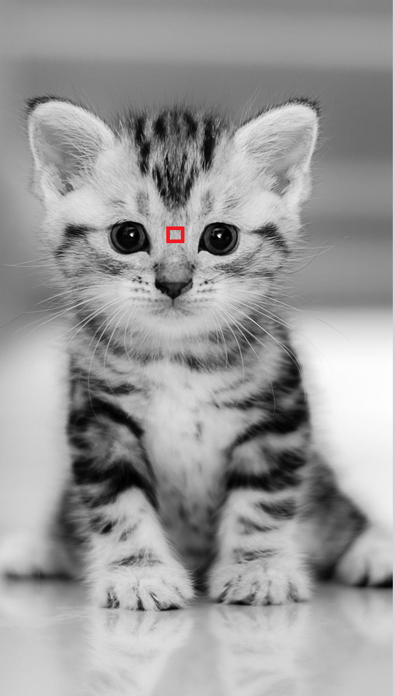
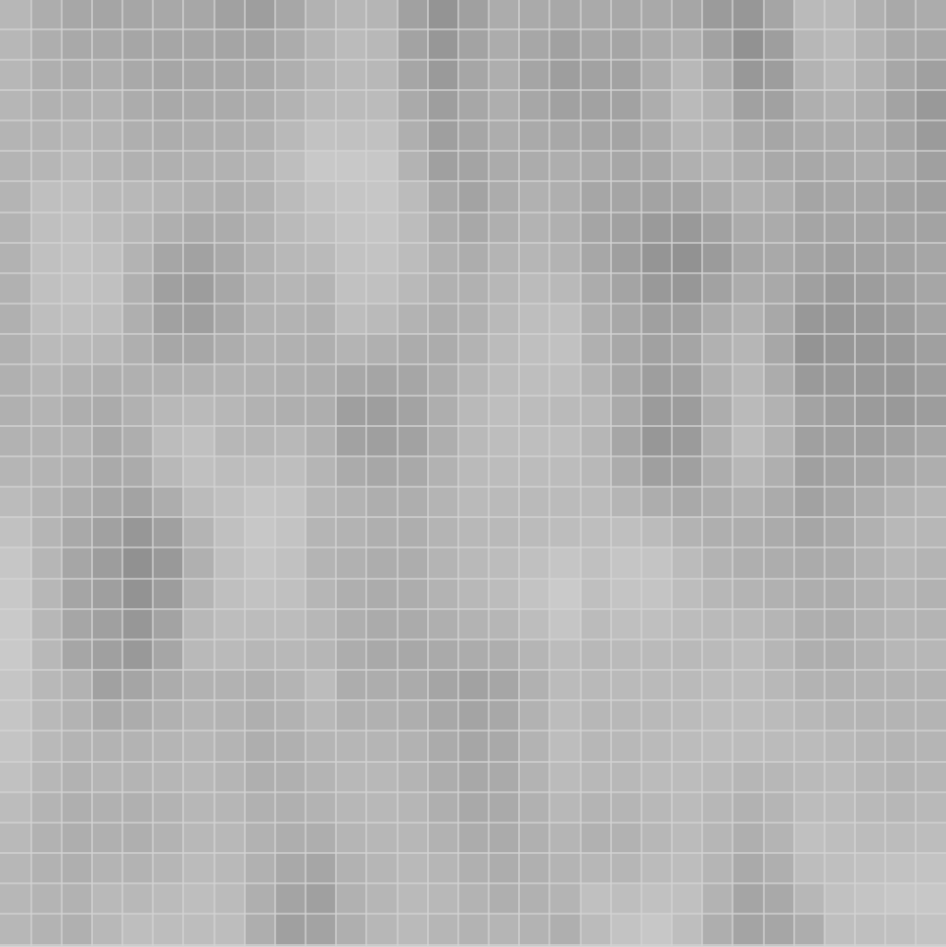


Bilateral Filter – Plain area
Space kernel 31x31,
sigmas = 15
Studying pixel
multiply
Intensity kernel 31x31, Sigmai = 75
0
1

Slide 10


Bilateral Filter – Plain area
origin
Bilateral:
kernel 31x31,
sigmas = 15,
Sigmai = 75
Gaussian
Kernel 31x31, sigmas = 15
0
1

Slide 11



Bilateral Filter
origin
Gaussian
Kernel 31x31, sigmas = 15
Bilateral:
kernel 31x31,
sigmas = 15,
Sigmai = 75

Slide 12
Bilateral Filter – Performance comparation
Blur (image 1080 x 1920) | Time
Bilateral Filter Opencv (kernel 31x31 sigma space = 15, sigma color = 75) | 150,94ms
Bilateral Filter My implementation 16Thread (kernel 31x31 sigma space = 15, sigma color = 75) | 1482,73ms
Bilateral Filter My implementation 1Thread (kernel 31x31 sigma space = 15, sigma color = 75) | 12266.5ms
Gaussian Filter opencv (kernel 31x31 sigma space = 15) | 90.98ms
Gaussian Filter My implementation 16Thread (kernel 31x31 sigma space = 15) | 710,685ms
Gaussian Filter My implementation 1Thread (kernel 31x31 sigma space = 15) | 5297,18ms

Slide 13

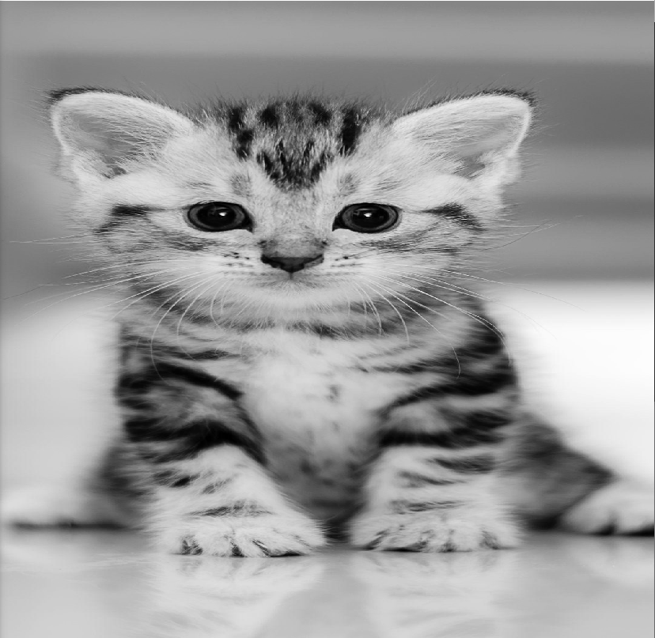

Bilateral Filter
Gaussian:
kernel 31x31, sigmas = 15
Bilateral:
Intensity kernel 31x31, sigmas = 15,
Sigmai = 75
Bilateral:
Intensity kernel 31x31, sigmas = 15,
Sigmai = 25
Bilateral:
Intensity kernel 31x31, sigmas = 15,
Sigmai = 0
Bilateral:
Intensity kernel 31x31, sigmas = 15,
Sigmai >=300

Slide 14
Bilateral Filter - Conclusion
Bilateral filter slower than Gaussian filter
Bilateral filter still have smooth effect in plain area
Bilateral preserves Edge regions
If color sigma = 0, result will not take any effect
If color sigma very large, result will be just the same as Gaussian filter with the same sigma and kernel

Slide 15

Thanks
주식회사 자비스
XAVIS Co,.Ltd.
Tel:031-740-3800 Fax: 031-740-3802
Email: xavis@xavis.co.kr URL: www.xavis.co.kr

